Slide 1


Dept of BT

Slide 2
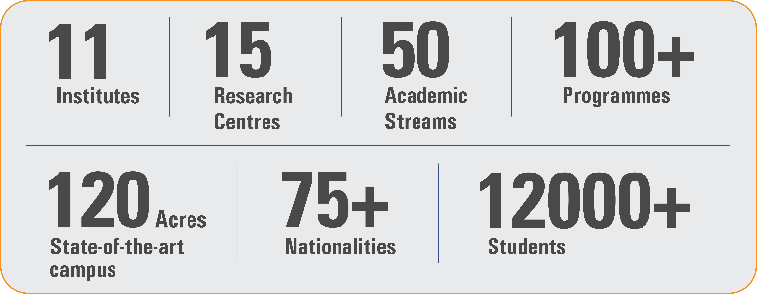
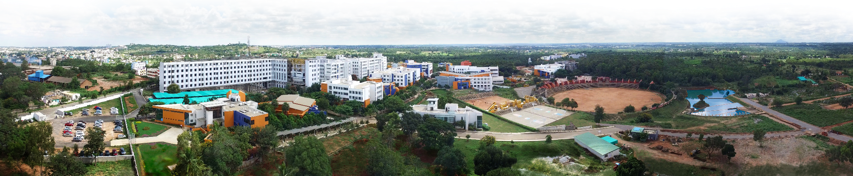
Overveiw
Acharya stands as a beacon of excellence in higher education, boasting a legacy of academic distinction since its establishment in 1990. We offer a transformative educational experience, fostering holistic development, nurturing innovation and providing world-class facilities to ensure an enriching journey for our students.
Dept of BT

Slide 3
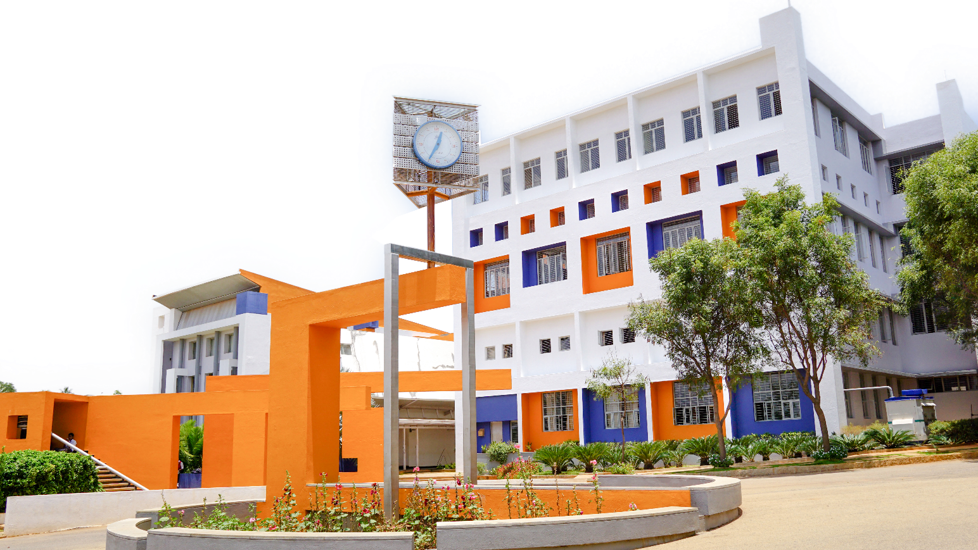
11 Institutions, Infinite Possibilities
We provide 100+ programs across 50 academic streams.
Dept of BT

Slide 4
Basic concepts of circular economy based on organics
The circular economy is a model aimed at minimizing waste and making the most of resources. When it comes to organics, this approach focuses on sustainable practices that enhance the lifecycle of organic materials. Here are some key concepts:
Waste Reduction: Emphasizing the importance of reducing organic waste through better resource management and consumption patterns.
Composting: Transforming organic waste into compost enriches soil, promotes biodiversity, and reduces the need for chemical fertilizers.
Biogas Production: Using anaerobic digestion to convert organic waste into biogas, which can be used for energy, thereby reducing reliance on fossil fuels.
Regenerative Agriculture: Practices that restore and maintain healthy soil ecosystems, enhance biodiversity, and improve carbon sequestration.
Dept of BT

Slide 5
Basic concepts of circular economy based on organics
Food Recovery: Implementing systems to redirect surplus food from landfills to food banks or other charities, reducing food waste and supporting communities.
Design for Longevity: Creating products and systems that are durable, repairable, and recyclable, minimizing the need for new organic resources.
Local Supply Chains: Encouraging local sourcing of organic materials to reduce transportation emissions and support local economies.
Consumer Awareness: Educating consumers about sustainable practices and the benefits of organic products to promote more mindful consumption.
Resource Sharing: Facilitating platforms for sharing organic materials (like community gardens) to maximize resource use and reduce waste.
Dept of BT

Slide 6
Biomass: Properties and Types
Biomass refers to organic material derived from living or recently living organisms, primarily plants and animals, that can be used as a renewable energy source. Here’s an overview of its properties and types:
Properties of Biomass
Renewability: Biomass is renewable as it can be replenished through natural processes (e.g., growth of plants and trees).
Energy Content: Biomass contains stored energy from the sun, which can be released through combustion, anaerobic digestion, or other conversion processes.
Carbon Neutrality: When biomass is burned, it releases carbon dioxide (CO2), but the plants that produced the biomass absorb CO2 during their growth, making it potentially carbon neutral.
Dept of BT

Slide 7
Biomass: Properties and Types
Moisture Content: The moisture level in biomass affects its energy efficiency; lower moisture content typically yields higher energy output.
Chemical Composition: Biomass consists mainly of carbohydrates, lignin, proteins, and fats, which influence its energy yield and combustion characteristics.
Biodegradability: Biomass is biodegradable, meaning it can break down naturally and can be converted into compost or biogas.
Dept of BT

Slide 8
Biomass: Properties and Types
Types of Biomass:
Woody Biomass:
Includes trees, branches, and wood residues.
Commonly used for bioenergy production, paper, and construction materials.
Agricultural Residues:
Byproducts from crop production, such as straw, corn stalks, and sugarcane bagasse.
Often used for biofuels, animal bedding, or soil amendment.
Energy Crops:
Plants specifically grown for energy production, such as switchgrass, miscanthus, and giant reed.
They are high-yield and often cultivated on marginal lands.
Animal Manure:
Waste from livestock that can be processed to produce biogas through anaerobic digestion.
Can also be composted to create organic fertilizers.
Algae:
Microalgae and macroalgae can be cultivated for biofuels, food, and animal feed.
They have high growth rates and can be grown in various environments, including saline water.
Dept of BT

Slide 9
Biomass: Properties and Types
Food and Yard Waste:
Includes food scraps, garden waste, and other organic materials.
Often processed through composting or anaerobic digestion for energy recovery.
Applications of Biomass
Biofuels: Biomass can be converted into liquid fuels (e.g., ethanol, biodiesel) for transportation.
Biopower: Biomass can be burned or converted into gas to generate electricity.
Bioproducts: Biomass is used to produce a range of products, including biodegradable plastics and chemicals.
Dept of BT

Slide 10
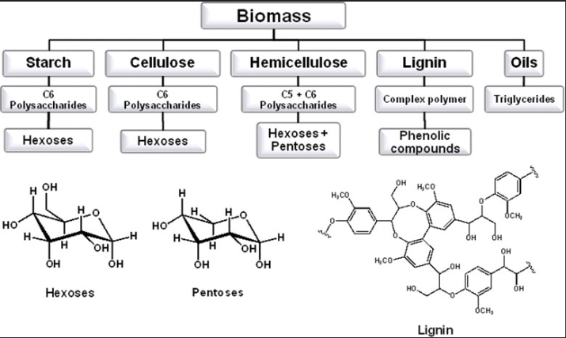
Biomass: Properties and Types
Dept of BT

Slide 11
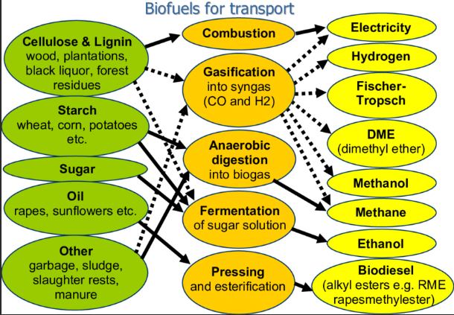
Biomass: constituents at molecular level, at chemical level, energy properties.
Dept of BT

Slide 12
Biomass: constituents at molecular level, at chemical level, energy properties.
Biomass is a complex material composed of various organic constituents at both the molecular and chemical levels. Understanding these components helps in determining its energy properties and potential applications. Here’s a detailed overview:
Molecular Constituents of Biomass
Cellulose:
A polysaccharide made of glucose units, forming the primary structural component of plant cell walls.
Provides rigidity and strength; it's a major component for biofuel production.
Hemicellulose:
A heterogeneous group of polysaccharides, consisting of various sugars (like xylose and mannose).
More soluble than cellulose and provides structural support; important for fermentation processes.
Lignin:
A complex organic polymer that provides rigidity and resistance to microbial degradation.
Makes biomass more difficult to break down but is a significant source of energy when combusted.
Dept of BT

Slide 13
Biomass: constituents at molecular level, at chemical level, energy properties.
Starch:
A carbohydrate made of glucose units, primarily found in grains and tubers.
Easily digestible and can be converted into ethanol.
Lipids:
Fats and oils found in seeds and other plant tissues, composed of fatty acids and glycerol.
Serve as a significant energy source and can be converted into biodiesel.
Proteins:
Composed of amino acids, these can be found in various biomass sources, especially in agricultural residues and animal waste.
Can contribute to energy content through combustion and are also valuable for animal feed.
Dept of BT

Slide 14
Biomass: constituents at molecular level, at chemical level, energy properties.
Chemical Composition
Carbon (C):
Biomass is predominantly carbon-based, which is crucial for its energy content.
Hydrogen (H):
Essential for the formation of organic compounds and contributes to the energy yield during combustion.
Oxygen (O):
Present in carbohydrates and affects the energy content and combustion properties.
Nitrogen (N):
Found in proteins and can influence the combustion characteristics and emissions of biomass.
Minerals:
Various inorganic elements (like potassium, calcium, magnesium) are present in trace amounts and can affect the ash content and emissions during combustion.
Dept of BT

Slide 15
Biomass: constituents at molecular level, at chemical level, energy properties.
Energy Properties of Biomass
Biomass has several properties that make it a viable energy source:
Calorific Value (Energy Density): Biomass has an average energy content of 15-20 MJ/kg (for dry biomass), which is lower than fossil fuels but can be enhanced through processes like densification or thermochemical conversions (e.g., pyrolysis).
Combustion Efficiency: Due to its organic composition, biomass burns more cleanly than coal, producing fewer sulfur and nitrogen oxides.
Renewability and Carbon Neutrality: Biomass is considered a renewable energy source, as it can be regrown. When burned, it releases carbon dioxide (CO₂) absorbed during growth, often considered “carbon neutral” if managed sustainably.
Thermochemical Conversion Suitability: Due to its molecular composition, biomass can be processed through methods like combustion, gasification, and pyrolysis to yield biofuels and other energy products. For instance:
Pyrolysis decomposes biomass at high temperatures in the absence of oxygen, creating bio-oil, syngas, and biochar.
Gasification partially oxidizes biomass to produce synthesis gas, a mixture of carbon monoxide, hydrogen, and other gases, which can be used for electricity generation or as a feedstock for biofuel synthesis.
Dept of BT

Slide 16
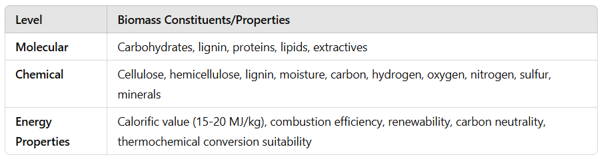
Biomass: constituents at molecular level, at chemical level, energy properties.
Dept of BT

Slide 17
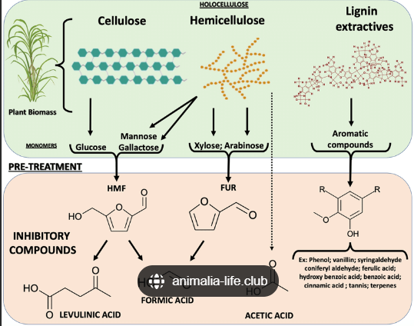
Biomass typologies: lignocellulosic, starchy, sugary, oilseeds, OFMSW, sewage sludge, manure.
Dept of BT

Slide 18
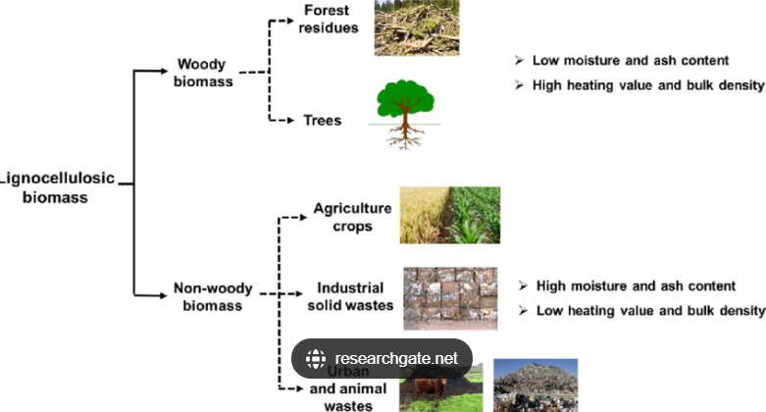
Biomass typologies: lignocellulosic, starchy, sugary, oilseeds, OFMSW, sewage sludge, manure.
Dept of BT

Slide 19
Biomass typologies: lignocellulosic, starchy, sugary, oilseeds, OFMSW, sewage sludge, manure.
Biomass is categorized into different typologies based on its origin, primary constituents, and applications. Here’s a breakdown of common biomass types:
1. Lignocellulosic Biomass
Composition: Contains cellulose, hemicellulose, and lignin as its primary structural components.
Examples: Wood, agricultural residues (e.g., straw, corn stover), forestry residues, energy crops (like switchgrass and miscanthus).
Characteristics: High fiber content and durability, but challenging to break down, especially the lignin component.
Uses: Used for bioethanol production, biogas, biochar, and as feedstock for thermochemical conversion (combustion, pyrolysis, gasification).
2. Starchy Biomass
Composition: Rich in starch, a complex carbohydrate made up of glucose units.
Examples: Corn, wheat, potatoes, cassava.
Characteristics: Starch is easily converted into fermentable sugars, making it suitable for quick conversion to biofuels.
Uses: Primarily used for bioethanol production through fermentation. Also serves as feedstock for bioplastic production.
Dept of BT

Slide 20
Biomass typologies: lignocellulosic, starchy, sugary, oilseeds, OFMSW, sewage sludge, manure.
3. Sugary Biomass
Composition: High in simple sugars (e.g., sucrose, glucose, fructose).
Examples: Sugarcane, sugar beet, sweet sorghum.
Characteristics: Contains readily fermentable sugars that need minimal processing before conversion to biofuels.
Uses: Mainly used for bioethanol production, as well as for other sugar-derived products.
4. Oilseeds
Composition: High in lipids (fats and oils), primarily triglycerides.
Examples: Soybean, rapeseed (canola), sunflower, palm oil, jatropha.
Characteristics: High energy density due to lipid content, making oilseeds ideal for biodiesel production.
Uses: Primarily used in biodiesel production through transesterification. Byproducts can be used in animal feed after oil extraction.
Dept of BT

Slide 21
Biomass typologies: lignocellulosic, starchy, sugary, oilseeds, OFMSW, sewage sludge, manure.
5. Organic Fraction of Municipal Solid Waste (OFMSW)
Composition: Diverse organic waste materials, including food scraps, yard trimmings, and paper products.
Examples: Household food waste, garden waste, biodegradable packaging.
Characteristics: Highly heterogeneous and variable in moisture content. Requires sorting and preprocessing.
Uses: Commonly used in anaerobic digestion for biogas production, as well as for composting and waste-to-energy applications.
6. Sewage Sludge
Composition: Organic matter, nutrients (like nitrogen and phosphorus), and microorganisms.
Examples: Sludge from wastewater treatment plants.
Characteristics: Nutrient-rich but often contains pathogens and contaminants that require treatment before use.
Uses: Anaerobic digestion to produce biogas, or after treatment, used as a soil conditioner or fertilizer.
Dept of BT

Slide 22
Biomass typologies: lignocellulosic, starchy, sugary, oilseeds, OFMSW, sewage sludge, manure.
7. Manure
Composition: Rich in organic matter, nitrogen, phosphorus, potassium, and microorganisms.
Examples: Animal manure from livestock such as cattle, poultry, and pigs.
Characteristics: Nutrient-rich and decomposes quickly, which can release greenhouse gases if unmanaged.
Uses: Commonly used in anaerobic digestion for biogas production and as an organic fertilizer to enrich soil.
Dept of BT

Slide 23
Biomass conversion: Chemical conversion, Oil trans-esterification (biodiesel production).
Biomass conversion into usable biofuels and chemicals can involve various methods, two key types of which are chemical conversion and oil trans-esterification for biodiesel production. Here’s an overview of each process:
Chemical Conversion
Chemical conversion processes are used to transform biomass into fuels or chemicals through reactions with chemicals, heat, or catalysts. These methods are particularly effective for converting lignocellulosic biomass and other complex organic materials. Some primary chemical conversion methods include:
Hydrolysis: Breaking down complex carbohydrates in biomass (like cellulose and hemicellulose) into simpler sugars, which can then be fermented into bioethanol.
Gasification: Heating biomass in a low-oxygen environment to produce synthesis gas (syngas), which is a mixture of hydrogen and carbon monoxide. Syngas can be further processed into biofuels or other chemicals.
Pyrolysis: Heating biomass in the absence of oxygen, breaking it down into bio-oil, syngas, and biochar. Bio-oil can be refined into biofuels, while biochar can be used as a soil amendment.
Dept of BT

Slide 24
Biomass conversion: Chemical conversion, Oil trans-esterification (biodiesel production).
Fermentation: A biochemical process often following hydrolysis, where microorganisms convert sugars into ethanol or other chemicals (such as biobutanol) under anaerobic conditions.
These processes can vary in temperature, pressure, and catalysts depending on the biomass type and the desired end product. Chemical conversion allows for a diverse range of end products, including biofuels, bioplastics, and platform chemicals for various industrial applications.
Dept of BT

Slide 25
Biomass conversion: Chemical conversion, Oil trans-esterification (biodiesel production).
2. Oil Trans-Esterification (Biodiesel Production)
Oil trans-esterification is a specific chemical conversion process used primarily to convert vegetable oils, animal fats, or waste oils into biodiesel. Biodiesel is a renewable fuel that can replace or supplement diesel in vehicles. The trans-esterification process is as follows:
Raw Material Selection: Oils from oilseeds (like soybean, sunflower, rapeseed, and palm), animal fats, or waste oils can be used.
Alcohol Addition: Methanol (or sometimes ethanol) is added to the oil, along with a catalyst. Methanol is the most common alcohol used because it is inexpensive and reacts quickly.
Catalyst Use: The process requires a catalyst, typically sodium hydroxide (NaOH) or potassium hydroxide (KOH), to speed up the reaction between the oil and the alcohol.
Trans-Esterification Reaction: In this reaction, triglycerides (the main component of oils and fats) react with alcohol in the presence of a catalyst to form biodiesel (methyl esters) and glycerol as a byproduct.
Separation and Purification: The biodiesel (methyl esters) is separated from glycerol, which can be refined and used in various industries (e.g., cosmetics, pharmaceuticals). The biodiesel undergoes washing and drying to remove impurities.
Dept of BT

Slide 26
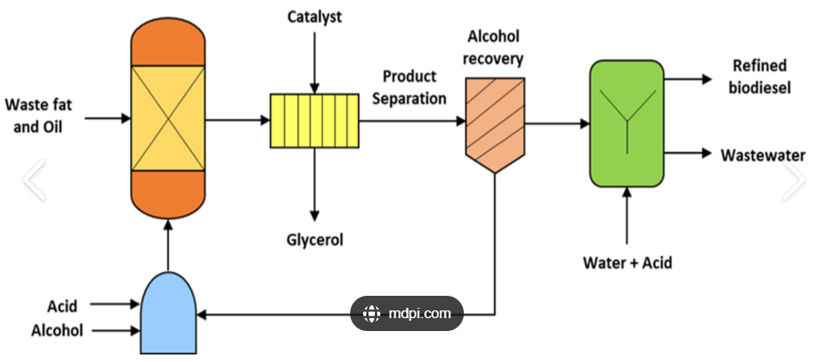
Biomass conversion: Chemical conversion, Oil trans-esterification (biodiesel production).
Dept of BT

Slide 27
Biomass conversion: Chemical conversion, Oil trans-esterification (biodiesel production).
Advantages of Oil Trans-Esterification:
Converts waste oils into usable fuel, reducing waste.
Produces biodiesel with lower emissions than petroleum-based diesel.
Biodiesel is biodegradable, nontoxic, and has a high energy yield.
Challenges of Oil Trans-Esterification:
Feedstock costs (particularly for vegetable oils) can be high.
Waste oils require pretreatment to remove impurities.
Producing biodiesel requires handling and disposal of catalysts and byproducts like glycerol.
Dept of BT

Slide 28
Biomass conversion: Biochemical conversion, Anaerobic digestion (biogas production from organic waste and wastewater).
Biochemical conversion, particularly through anaerobic digestion, is a significant method in biomass conversion for producing biofuels and managing organic waste. Here’s a breakdown of how these processes work:
1. Biochemical Conversion
Biochemical conversion uses biological processes, such as the activity of enzymes or microorganisms, to convert organic biomass into energy-rich fuels. It is especially effective for processing organic wastes, agricultural residues, and wastewater. The most common methods in biochemical conversion include fermentation (for producing bioethanol from sugars) and anaerobic digestion (for biogas production).
Primary Biochemical Conversion Processes:
Fermentation: Converts sugars from biomass into bioethanol using yeast or other microorganisms.
Anaerobic Digestion (AD): Uses bacteria to break down organic material in the absence of oxygen to produce biogas.
Dept of BT

Slide 29
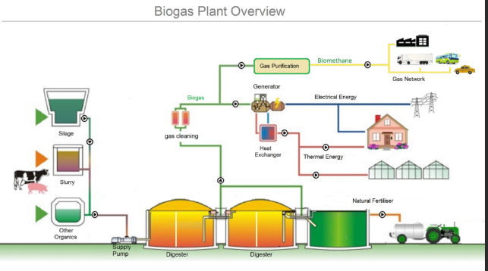
Biomass conversion: Biochemical conversion, Anaerobic digestion (biogas production from organic waste and wastewater).
Dept of BT

Slide 30
Biomass conversion: Biochemical conversion, Anaerobic digestion (biogas production from organic waste and wastewater).
2. Anaerobic Digestion (AD)
Anaerobic digestion is a microbial process that converts organic materials like food waste, agricultural residues, and wastewater sludge into biogas (a mixture of methane and carbon dioxide) and digestate (a nutrient-rich byproduct). This process is particularly beneficial for waste management and renewable energy production.
Steps of Anaerobic Digestion:
1.Hydrolysis: Large organic molecules (proteins, fats, and carbohydrates) are broken down into simpler compounds (amino acids, fatty acids, and sugars) by bacteria.
2.Acidogenesis: The simple compounds are further broken down into volatile fatty acids, ammonia, carbon dioxide, and hydrogen by acid-producing bacteria.
3.Acetogenesis: Bacteria convert volatile fatty acids into acetic acid, as well as additional hydrogen and carbon dioxide.
4. Methanogenesis: Methanogenic bacteria convert acetic acid, hydrogen, and carbon dioxide into methane and water, creating biogas.
Dept of BT

Slide 31
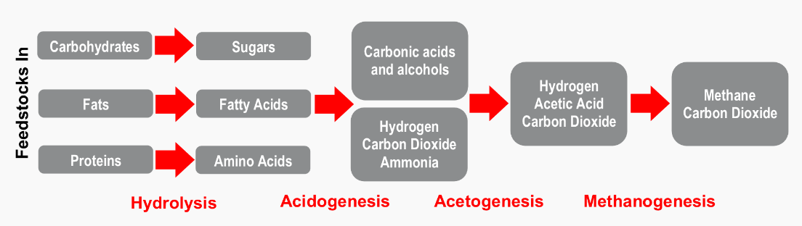
Biomass conversion: Biochemical conversion, Anaerobic digestion (biogas production from organic waste and wastewater).
Dept of BT

Slide 32
Biomass conversion: Biochemical conversion, Anaerobic digestion (biogas production from organic waste and wastewater).
Anaerobic digestion can occur in three different temperature ranges, with the most reactors using the second and third ranges:
psychrophilic (41-68°F)
mesophilic (77-95°F), and
thermophilic (122-140°F) conditions.
The microbial communities present in one temperature range are not the same as the ones occurring in another temperature range, and thus decreases in biogas production might occur when temperature ranges are not maintained. In general, for optimal biogas production, the anaerobic digester should be kept at a constant temperature.
Alkalinity is necessary for pH control and acts as a buffer against acid formation during acidogenesis. Methane-producing bacteria (methanogens) are sensitive to pH change and operate optimally between a pH of 6.8 and 7.2.
Dept of BT

Slide 33
Biomass conversion: Biochemical conversion, Anaerobic digestion (biogas production from organic waste and wastewater).
Digester types:
There are two general classifications of digesters based on the flow through the digester vessel.
Plug-flow digester: A plug flow digester vessel is a long, narrow, insulated, and possibly heated vessel made of reinforced concrete, steel or fiberglass with a gas-tight cover to capture the biogas. The plug flow digester normally functions without internal agitation.
Complete-mix digester: A complete-mix digesters is typically an above- or below-ground tank that is part of a manure management system to handle manure containing 2 to 10 percent solids.
Dept of BT

Slide 34
Biomass conversion: Biochemical conversion, Anaerobic digestion (biogas production from organic waste and wastewater).
Products of Anaerobic Digestion
Biogas: Composed primarily of methane and carbon dioxide, biogas can be used to generate heat and electricity, or upgraded to biomethane (a purified form of biogas) suitable for natural gas grids and vehicle fuel.
Digestate: The remaining nutrient-rich material is called digestate. It can be used as a biofertilizer, providing valuable nutrients like nitrogen, phosphorus, and potassium for crops.
Dept of BT

Slide 35
Biomass conversion: Biochemical conversion, Anaerobic digestion (biogas production from organic waste and wastewater).
Applications and Benefits of Anaerobic Digestion
Renewable Energy Production: Biogas serves as a renewable energy source, reducing dependence on fossil fuels and promoting sustainable energy practices.
Waste Reduction: By converting organic waste into biogas, anaerobic digestion minimizes the amount of waste sent to landfills, reducing methane emissions and associated environmental impact.
Nutrient Recycling: Digestate offers an environmentally friendly alternative to synthetic fertilizers, providing essential nutrients that enhance soil health and fertility.
Greenhouse Gas Mitigation: Anaerobic digestion helps reduce greenhouse gas emissions by capturing methane, which would otherwise escape into the atmosphere if waste was left to decompose in a landfill.
Versatile Applications: Anaerobic digestion is widely used in various sectors, including wastewater treatment facilities, farms, and food processing industries, where it provides an effective way to manage organic waste and generate renewable energy.
Dept of BT

Slide 36
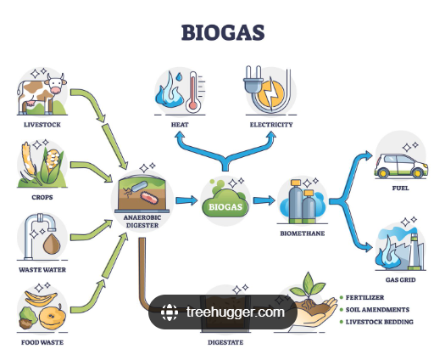
Biomass conversion: Biochemical conversion, Anaerobic digestion (biogas production from organic waste and wastewater).
Applications and Benefits of Anaerobic Digestion
Dept of BT

Slide 37
Biomass conversion: Biochemical conversion, Anaerobic digestion (biogas production from organic waste and wastewater).
Example of Biogas Utilization
Biogas for Electricity and Heat: Many biogas plants use biogas to generate electricity and heat through combined heat and power (CHP) units. This approach is common in wastewater treatment facilities, which can then use the heat for plant operations and the electricity to offset energy costs.
Biomethane for Vehicles: Biogas can be refined to biomethane, which is compatible with natural gas pipelines or can be compressed and used as a vehicle fuel, offering an alternative to gasoline or diesel.
Dept of BT

